Slide 1
Chemical Engineers
NSBE An Engineer

Slide 2
Who is a Chemical Engineer?
An individual that graduated from a 4 year college or University with a Bachelor’s in Science degree
Are you next?!
Dr. Mae Jemison was the first African American Women in space. She received her B.S. in Chemical Engineering at Stanford University at the age of 20!

Slide 3
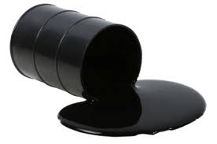
What does a Chemical Engineer do?
A chemical engineer focuses on the processes involved with transforming raw materials into usable products
Chemical engineers apply their skills in science, math, environmental management, and business to make production processes more efficient and profitable
Petroleum
Plastic
Notes:
https://youtu.be/0itSS6ATWvM

Slide 4
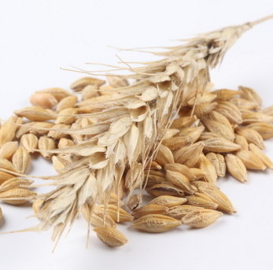
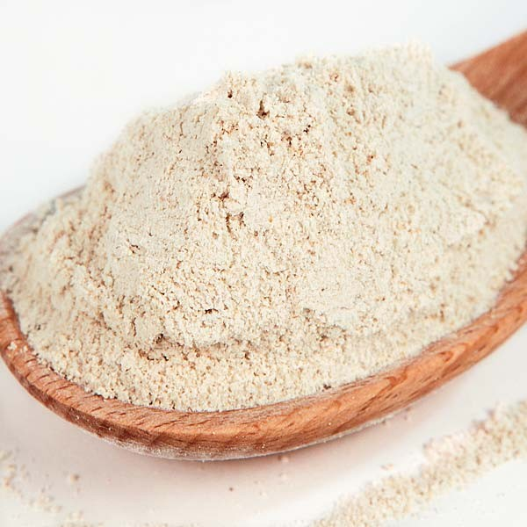
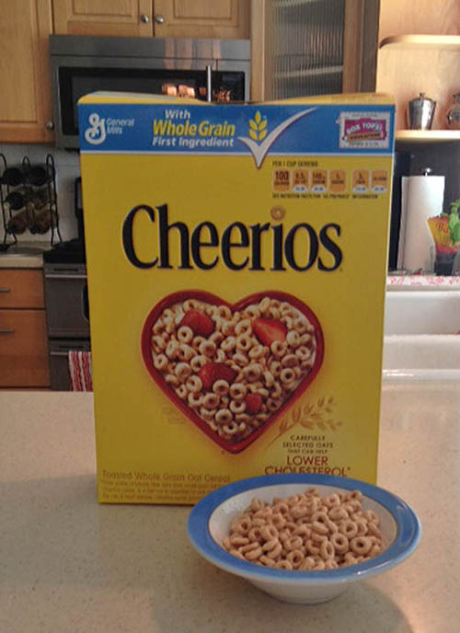
Example: Cheerios
Oats
Flour
Dough
Cooked &
Made into Flour
Blending
Cook
Cut into Shape
Can you taste the difference?
Bake and Flavor
Notes:
Materials: Have generic cheerios and Yellow Box name brand cheerios
Chemical Engineers at General Mills have mastered the process of making cheerios. The process begins with whole oats from the field, they are milled and cooked into an oat flour, the flour is then mixed with other ingredients (water, sugar, salt etc.) to make a dough. Similar processes are done to make doughs for cakes, breads, cookies, etc. So, what gives us a cheerio instead of a cake?.................. The dough ingredient and the cooking process! All of which are dictated by chemical engineers.
Cheerios have a top secret cooking process that gives it the simple goodness taste that most generic brands can’t match. After this cooking process the cheerios are cut into their circle shape, baked and coated with flavor (honey if honey nut cheerios).
Extruded Cereals (like coco puffs, trix, kix, etc.) video: https://youtu.be/gK45ZcnVG-c

Slide 5
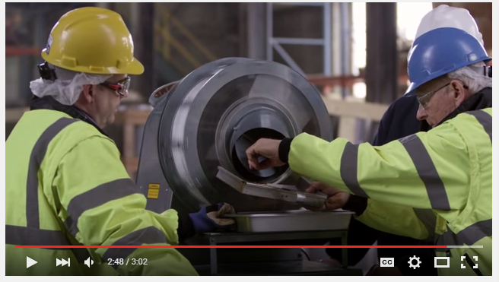
New Application!!! Gluten Free Cheerios
https://youtu.be/Wfe8k9mzvSI

Slide 6
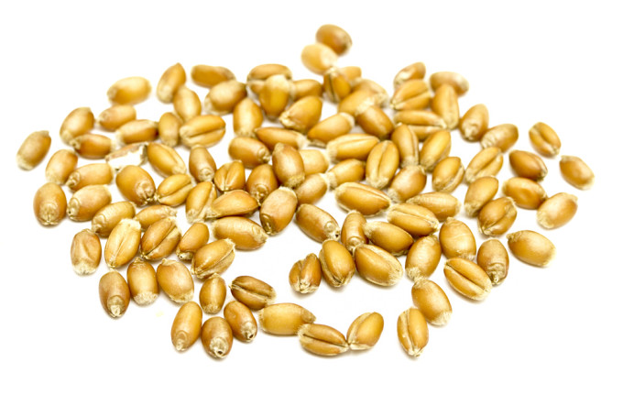
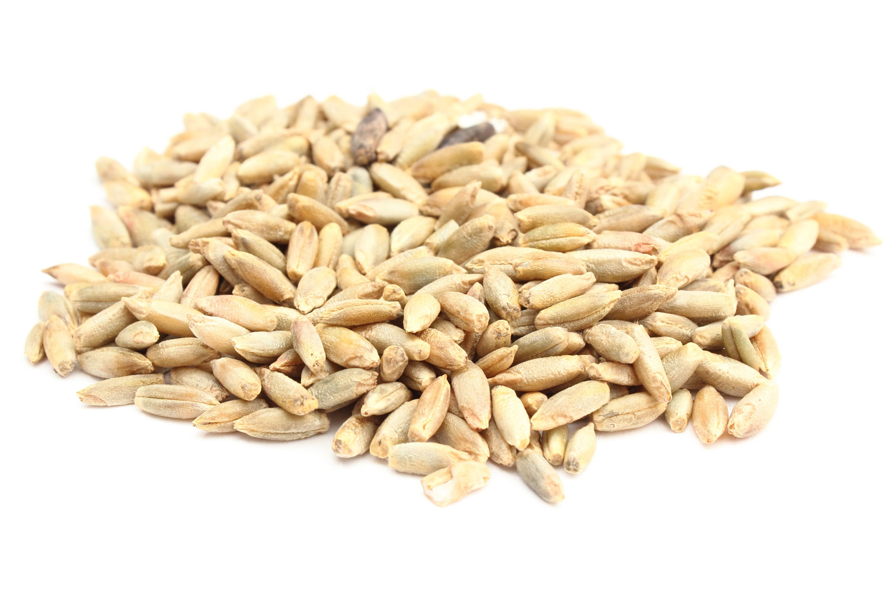
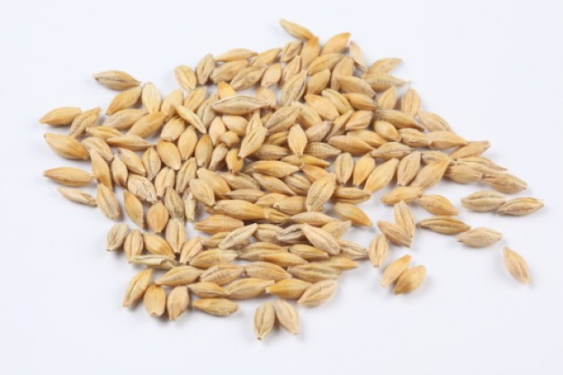
Process Development: Case Study - Let’s go Gluten Free
Wheat Grain
Barley Grain
Rye Grain
Oat Grain
Red
Skittles
Yellow
Skittles
Purple
Skittles
Pretzel
M&M
Notes:
If we want the Pretzel m&m separated from the other m&m’s how can we design a process that does that efficiently?
First: We analyze the problem and our variables. What is different between our 4 options. They have different compositions, which means they have different weights. How can your students design some process or tool that can separate the heavy pieces/big pieces from your chosen piece.
Think of a sifter, or a shaking table. The students should use a card board box with sides (12 pack soda cardboard box) and cut out precise holes that are only large enough to get rid of the unwanted skittles so that the big M&Ms are on top.

Slide 7
You need:
Scissors/ sharp knife that can cut cardboard precisely
Shoe Box (Cardboard box)
Peanut M&Ms (Can substitute with similar sized candy)
Skittles
Pens/pencils/markers
Rulers
Bowls

Slide 8
Advisor’s Eyes only!!
1. Measure the Skittles and M&M
2. Draw holes on box that are big enough for the skittles to fall through but too small for m&m
3. cut out holes in box (may require assistance)
4. Place process box over a bowl
5. pour the candy in box, shake and sift
6. Challenge: Challenge one team to use the process box while the other team has to separate by hand. See which team finishes faster. The process box should be faster
Engineers make things easier, cheaper, and more efficient

Slide 9
How much does a Chemical Engineer make?
The lowest 10 percent earned less than $58,830,
Top 10 percent earned more than $154,840.
Median yearly salary was $94,350 in 2012*
HS
4
8+
Police: $56,980 (2012)
Chemist: $73,060 (2012)
Doctor: $187,200 (2012)
Notes:
$94, 350 (2012) http://www.bls.gov/ooh/architecture-and-engineering/chemical-engineers.htm
HS – High School diploma and higher
4 – Requires a 4 year college/university degree
8+ - Requires at least 4 year college/university degree, 4 years of medical school, and additional school for specializations
* A June 2013 salary survey by the American Institute of Chemical Engineers of their members reported the median yearly salary of graduates of bachelor's degree programs in 2011.

Slide 10
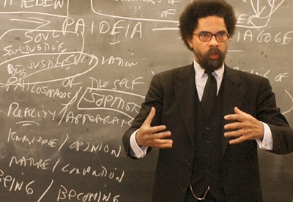
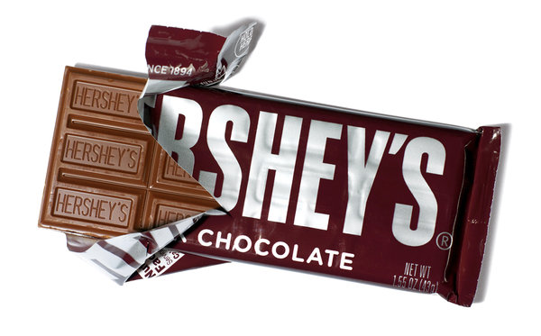
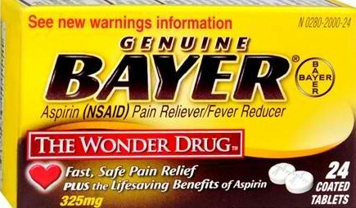
What industries hire Chemical Engineers
Oil and Gas
Consumer Goods
Pharmaceuticals
Academia
And so much more….

Slide 11
What classes should I take (now) for Chemical Engineering (later)
Math
Algebra by 7th Grade
Calculus in High School
4 years of math in high school
AP, IB, Honors, Community College classes
Science
Biology
Chemistry
Physics
4 years of science in high school
AP, IB, and Honors, Community College classes
That does NOT mean your other subjects don’t matter

Slide 12
Typical Chemical Engineering Freshmen Year of College
1st Semester
Calculus 1
General Chemistry 1
Physics 1
Engineering Computing 1
Elective 1 (Psychology, Spanish, Theatre, History, English, etc.)
2nd Semester
Calculus 2
General Chemistry 2
Physics 2
Engineering Computing 2
Elective 2
Notes:
Taking AP classes or community college courses (and doing well) could allow you to test out of the general required courses (AP scores of a 4 or a 5 typically). If you don’t test out, you are still exposed to the same material that you will be tested on in college. Thus, taking the suggested advanced courses in high school will better prepare you in college.

Slide 13
Polymerization
Polymer: A chain of many smaller repeating units (monomers) connected by covalent bonds
Plastic is made this way (Polyethylene, Polypropylene, Polystyrene)
Let’s Try!!!

Slide 14
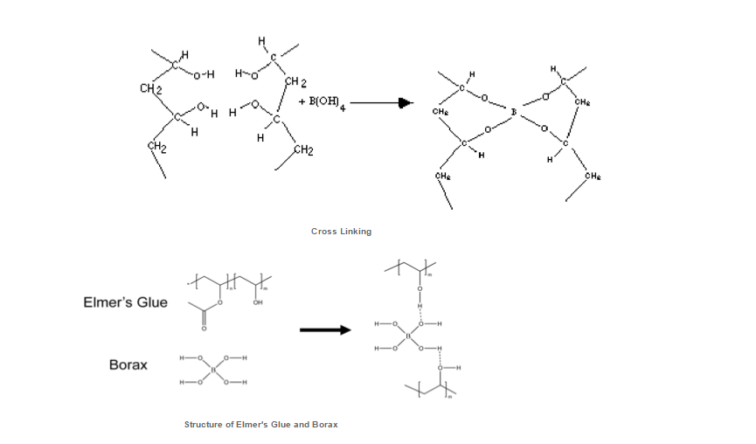
Silly Puddy Activity
Notes:
http://dlcblogforlab.blogspot.com/2012_12_01_archive.html
https://www.teachengineering.org/view_activity.php?url=collection/csu_/activities/csu_polymer/csu_polymer_lesson01_activity1.xml

